Slide 1
Git Part 2: The Command-Line Conceptual Barrier
Developed by:
OU’s Student Chapter of the Association for Computing Machinery (SACM)
OU’s Student Chapter of the Association for Women in Computing (AWC)
Delivered by:
Clay Curry, Computer Science ‘22
Several slides adapted from the open-source book, “Pro Git” by Chacon and Straub
https://git-scm.com/book/en/v2
This work is licensed under a Creative Commons Attribution 4.0 International License
https://creativecommons.org/licenses/by-sa/4.0/
Notes:
The majority of this presentation was adapted from an Ebook called “Pro Git”, meaning that this presentation is also licesened under a creative commons license

Slide 2
About Me
Computer Science Senior
Assistant system administrator in OU Department of Physics
Treasurer of:
Student Chapter for ACM,
Association for Women in Computing
Triangle Fraternity
Need your Survey feedback:
too much information
too little information

Slide 3
About This Workshop
Preceding Presentation to:
Intro to Git Core Concepts
branching
logging
exploring open-source projects
Topics for this Presentation:
Command-Line Interface
Git at a high level
Git everyday commands
For for this Presentation:
Download Discord
Make a GitHub account (https://github.com/; use OU Email)
Download Git For Windows (https://git-scm.com/download/win)
Notes:
Git has become cornerstone in all things related to software. Knowing how to program is easy, knowing how to be a useful programmer and engineer requires knowing Git.
Exploring and creating open-source projects
Git Core Concepts:
Branching
Pulling from files

Slide 4
About SACM and AWC
Student Chapter of Association for Computing Machinery
Student Chapter of Association for Women in Computing
JOIN OUR DISCORD: bit.ly/sacm_ou

Slide 5
Scope*
Overview
What is Git (high level)?
The Command Line
Basic Commands
Output Redirection
What is Git (every-day level)?
What are the core concepts?
Branching
Remotes
Merging
Logging
Distributed Workflow
Understanding Documentation
Notes:
*not included in final presentation

Slide 6

The Command-Line
BIG IDEA: A Command Line (CLI) does nothing more than invoke (“call”) other computer programs (processes)
completely analogous to how computer programs invokes subroutines (”functions”, “methods”)
Computer Program: program_name
call stack
data:
heap
call stack
instructions:
variable assignments
operators ($+$, $−$, $×$, $/$)
subroutine calls
input
subroutine1
output
input
subroutine2
output
input
subroutineN
output
Notes:
GUI – user initiates actions by choosing (point & click) from a palate of icons, buttons, sliders, drag n drop; usually local application
Users are reminded of all the actions available to them.

Slide 7
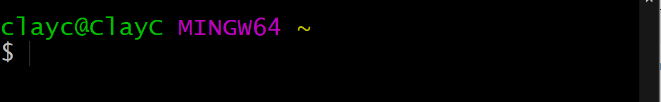

CLI Commands
Prompt
Program – packages data and instructions (written in a programming language like Java, C++, Python) executed by the machine
Commands always start with the name of the program you would like to run, followed by arguments separated by spaces
example: You can ask where programs are located by running
$ whereis program_name (in Linux) or $ which program_name (in Git Bash)
Notes:
When the shell is first opened, you are presented with a prompt indicating that the shell is waiting for input
Machine name @ username.
My personal preference is to think of each command as if it were a computer program function that I wrote myself in a language like Java. Just like every function, a computer program takes a specific kind of input (string, file name), transforms the data using a specific set of steps, then outputs the data as indicated by the instructions

Slide 8
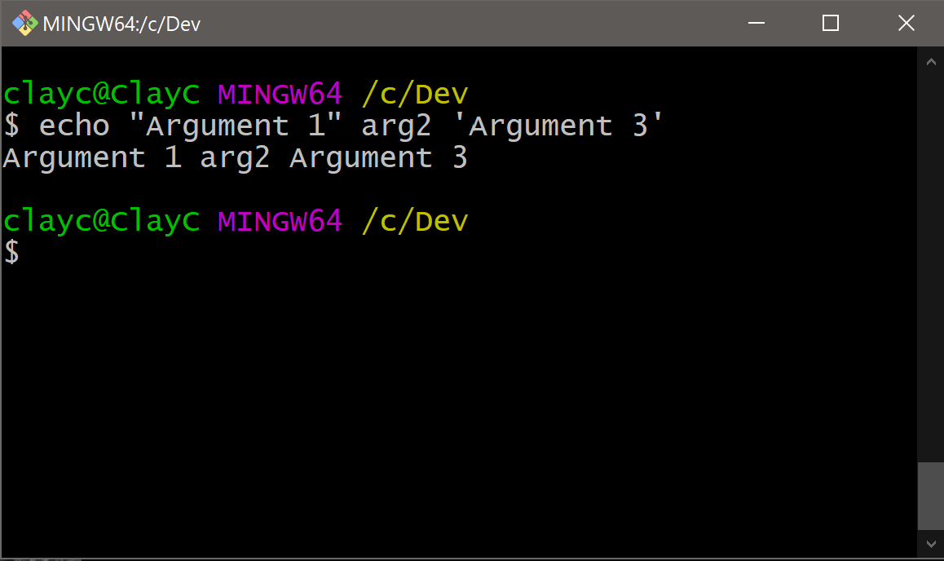
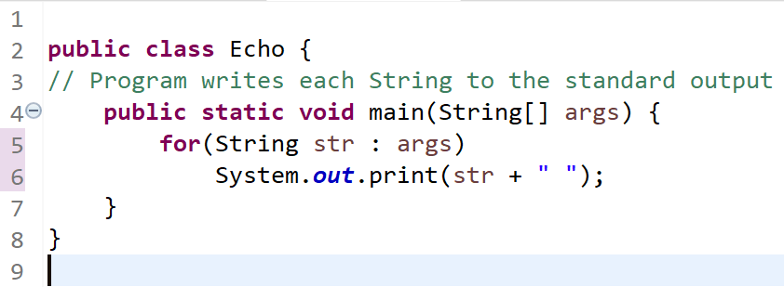
Invoking Computer Programs
What do CLIs do (Shell, Terminal, etc.) – create, read, update, and delete files by calling programs and passing arguments
Like GUI’s, a CLI is simply another way to invoke computer programs
program name
arguments
output

Slide 9
GUI vs CLI
GUI
Easier to pick up
Often little/no documentation
Limited to user-level personal computer (PC) programs
Isolated
Repetitive
Greater computing overhead (graphical rendering)
CLI
More mental work (cheat sheets help)
Documentation is usually available
Runs on everything (PC’s OS, cars, microcontrollers, phones, servers, appliances, IOT devices,)
Output redirection (inter-program communication)
Scriptable
Little overhead (programs usually only call what they need)
Notes:
As developers, we are constantly learning new tools and technologies to create and maintain our own tools. You get used to being confused. That is the point of learning and growing
In GUIs, actions are typically limited to single actions in single files inside single computer applications. The largest benefit to using the command line is the tools it provides you to chain commands and computer programs together, so to get the best features out of each. Imagine the power of being able to harness the word processing power of MS word, the graphical development power of Adobe illustrator, and the document control power of Adobe Acrobat. Though it would be nice, the very nature of GUIs makes this impossible.
The practicalness of GUIs comes from their ability allow the user to always know what options are available to them. However, the set needs for each user depends on the task at hand (writing paragraphs, editing photos, browsing web pages, creating diagrams, writing code). If a GUI presented all possible actions of the computer at all times, nothing would get done. This fact fundamentally makes GUI unable to harness the full power of the computer nor its users.
Many actions like making similar folders, editing similar files, and deleting stuff requires the user to execute the same few actions over and over. The whole purpose of having computers is to make human beings do less work. Repetition has no business in the computing world because we are able to master the art of writing scripts. Similarly, calling commands with many arguments can be shortened using aliases

Slide 10
Various Names / Flavors / Options
“shell” – CLI exposing all programs and system calls on an operating system (system calls form the kernel of the operating system)
Linux: Bash, Csh, Zsh, Korn, …
Windows: Command Prompt, PowerShell

Slide 11
EX) Bash
On GNU/Linux operating systems, Bash is the default shell
On MacOS, run chsh -s /bin/bash (change shell)
(restart terminal)
On Windows, install: Git Bash (easy to install)
On Windows, install: WSL, a Windows/Linux Distribution, and use Windows Terminal (optional, can be difficult)

Slide 12
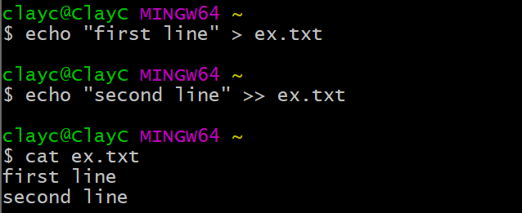
The Mental Work – Memorize UNIX commands
Great tutorials at http://swcarpentry.github.io/shell-novice/ or https://missing.csail.mit.edu/2020/course-shell/
When come across a program you don’t know, LOOK IT UP.
If things still don’t make sense, ASK FOR HELP (office hours)
Example: output redirection

Slide 13
Program | Usage
echo ARG1 ARG2 … | Prints (or echos) each argument as a string to the command line output
cat FILE1 FILE2 … | concatenates the contents of FILE1, FILE2, ..., then prints everything to output
pwd | prints the current working directory where the open shell is located to the output
ls | lists the contents of the current working directory where the open shell is located
cd PATH | change the current working directory to the one at the relative PATH
cp SRC DEST | copies the contents from SRC to DEST
rm FILE1 FILE2 … | removes (deletes) FILE1, FILE2, from the current directory
mv | moves or (usually) renames SRC to DEST (either a file or directory)
mkdir NAME | makes a new directory called NAME in the current working directory
rmdir NAME | removes the directory (if empty) called NAME in the current working directory
Operator | Operator Meaning
PRGM > FILE | creates/overwrites FILE with output of PRGM
PRGM >> FILE | creates/appends FILE with output of PRGM
PRGM < FILE | executes PRGM with the content of FILE as input
PRGM1 | PRGM2 | executes PRGM1 then uses output of PRGM1 as input for PRGM2
Getting Help | Command
Mac and Linux | man PRGM
Git Bash (Windows) | PRGM --help
[CTRL] + C | Cancel program
[CTRL] + L | Clear screen
Notes:
Run “which”

Slide 14
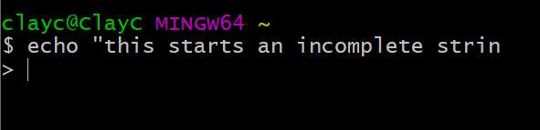
Extremely Useful Shortcuts
[Ctrl] C cancel program (for when you screw up)
[Ctrl] L clear screen
[Ctrl] A moves cursor to start of line
[Ctrl] E moves cursor to end of line
Example: Screwing Up
Begin quote
No end quote
“>” Indicates an unfinished command
No end quote
Notes:
Frankly, I should have learned these shortcuts long before anything else

Slide 15
Ex: Create a “developer folder” for your projects
Being a productive developer involves organizing all your code
Using only the command line,
Change to the home directory,
Make a new directory inside the home directory called, “Example”
Make another directory inside the home directory, “Java”
Rename “Example” to “Dev”
Move “Java” so that it is a subdirectory of “Dev”.
Rename “Java” to “Java_Projects”
Change to the “Java_Projects” directory
Write “the first line” to a new file called “hello” file
Write “the second line” to the second line of “hello” file
Bonus
Change hello so that Applications know it contains Java source code
(hint: Appliations tend to check the file extensions)
cd ~
mkdir Example
mkdir Java
mv Java/ Example/
mv Example/ Dev/
mv Dev/Java Dev/Java_Projects
cd Dev/Java_Projects
echo “the first line” > hello
echo “the second line” >> hello

Slide 16
Break
Upcoming: Small hands-on command-line tutorial
Notes:
Split into

Slide 17
2. Git at a High Level
What Git is
What Git is not
How does Git work?
What does Git not do?

Slide 18
What Git is
Version Control System (VCS)—a computer program that records changes to the set of files constituting a project and provides quick access to all versions of the project
Multitasking: work simultaneously with old and future (in-development) versions
Recoverability: if a bug is discovered in a project, easily revert to previous versions
Collaborative: provides tools for merging your work with other people’s work
Decentralized (on shared projects): each machine typically has a complete backup
Scalable: useful for single-developers and massive distributed projects
Shell & Plug-In Independent
Notes:
Git is a Version Control System for tracking/organizing changes in computer programs, and designed to optimizing tracking source code
Created in 2005 by Linus Torvalds.
No specific language or application needed to use Git
Works for static html websites, Node JS, Java, Python, C++; because all it does is store files
DECENTRALIZED Version Control: There are many version control systems that require being on a specific network for looking up older versions of a file. Without a connection on to the central code base, it can be impossible to, jump to a newly discovered critical issue, jump to a new feature in development, or view previous versions of a file
SCALABLE:
MULTITASKING: (Helps you solve problems in a more organized way)
COLLABORATIVE: Track who made what changes and when
RECOVERABLE:
Once you know the tools

Slide 19
What Git is not
Beginner friendly (varies in difficulty based on your background)
Hard to master (if you put time into it)
A graphical “point-and-click” program
A website (that is GitHub, built for Git)
Notes:
GitLab, BitBucket

Slide 20
How Does Git Work?
Takes “annotated snapshots” (commits) of an entire folder and subfolders and organizes snapshots in a hidden folder called “.git” (repository)
A repository is organized like an old-fashioned photo album
Selectively chooses files to include in the next photoshoot
Compare changes to files over time
See who last modified a file
Revert entire project back to a previous state
Notes:
You would not include your new significant other in the family photo. Similarly, you would not want to include temporary files, because the purpose of git is to track the long term changes of individual files.

Slide 21
What does Git Not Do?
Does not support live code collaboration (use https://codeshare.io)
Work well without other CLI commands: pwd, ls, cd, echo, cat, mv, rm, mkdir, rmdir, >, >>, |
Support any particular GUI interface (there are many, like GitKraken)

Slide 22
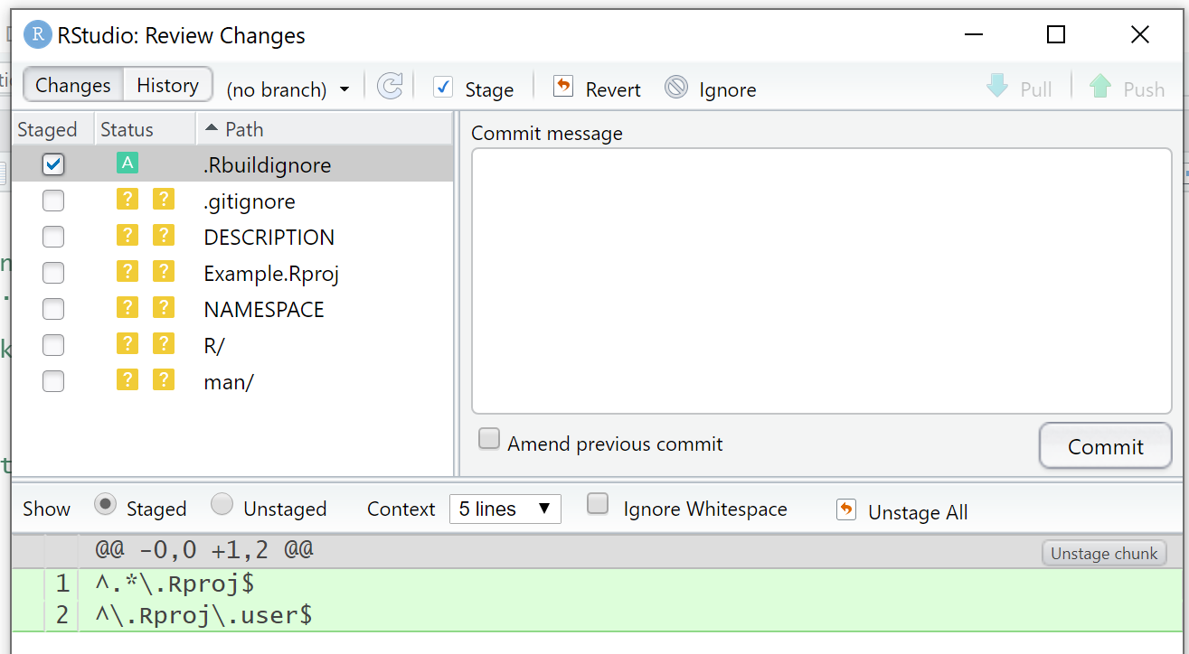
Why you should use Git on the command line
Applications hide functionality
Applications typically use the command line (they will usually show you this too)
Git GUI applications often break and are extremely difficult to fix (usually on the command line)
Example: Git in R Studio
Git GUI applications are difficult to use, limited in use, and hinder collaboration

Slide 23
Setting Up Git Bash
Mac/Linux: Git ships with operating system by default
Windows: https://git-scm.com/download/win
Adjusting name of initial branch: Let Git decide
Save in default location
git config --global user.name “your name”
git config --global user.email “your email”
git config --global core.autocrlf true
git config --global --list (view the above contents of ~/.gitconfig)
Notes:
You can create repository specific configurations, but this is pretty advanced
Set carriage return line feed

Slide 24
Git Commands
git init // Creates the .git folder in the current directory
git add <file> // Add files to the Index
git status // Checks the Status of Modified, Index
git commit // Creates a new Commit object
Notes:
So many technicalities.

Slide 25
Git Repository
Any folder containing another (usually hidden) folder named .git
.git contains literal snapshots of the entire repository
Don’t ever modify .git
git init // creates a .git folder
Example Git Repository
Working Snapshot 4
File 1
File 2
.git
Snapshot 1
Directory 1
Snapshot 2
File 3
Snapshot 3
File 4
File 5
Repository
Infrastructure
Notes:
Each new snapshot becomes a node inside .git
Each node is connected to its predecessor

Slide 26
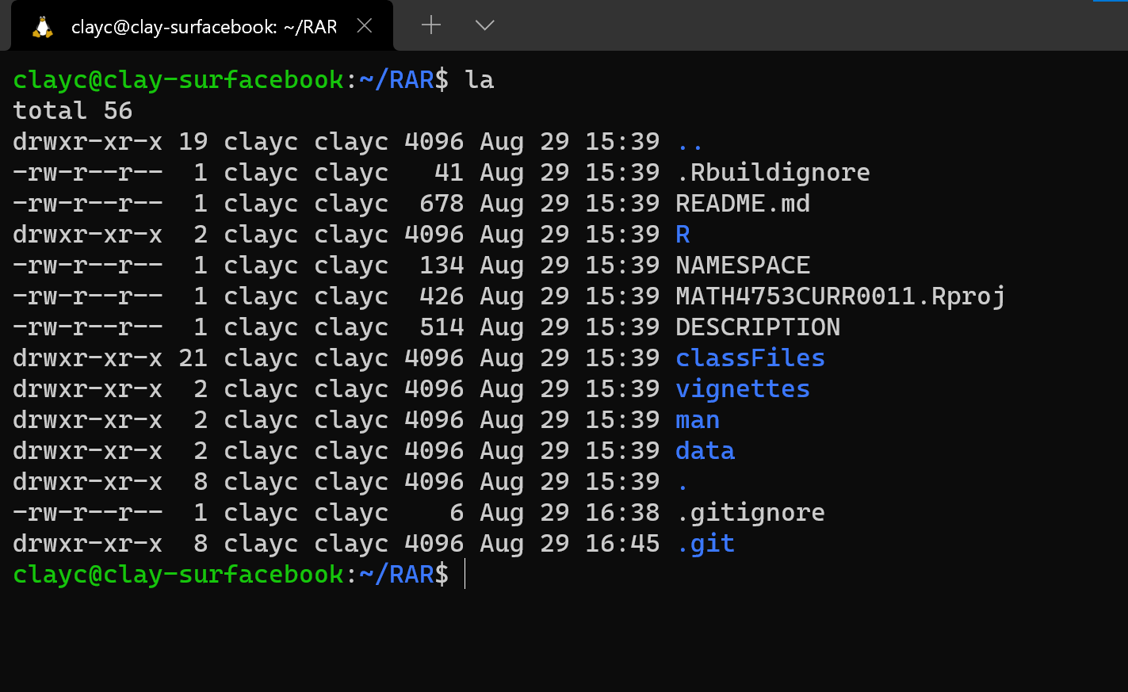
Git Repository
Any folder containing another (usually hidden) folder named .git
.git contains literal snapshots of the entire repository
Don’t ever modify .git
git init // creates a .git folder

Slide 27
Git Repository
Dev
Example Git Repository
Branch: n/a
Branch: main
Java_Projects
Java_Projects
Hello
Hello
.git
git init
Repository
Infrastructure

Slide 28
Four Stages of a File
Untracked – file exists but has not been added to the photo album
Modified – file is committed to the database but no longer up to date
Staged – marked as modified and to be committed to database upon next screenshot
Committed – file version is safely stored in .git
git init
edit & save file
edit & save file
Most common state for files
Default state for all files
git rm <filename>
git restore --staged <filename>
git commit –m “message”
git add <filename>
git add <filename>
(takes screenshot of Index)
Untracked
Modified
Staged/Index
Committed/Tracked
(files not included in next screenshot)
(files not included in next screenshot)
(files is included in next screenshot)
(File has been screenshotted)
Notes:
A lot like bringing a significant other to a family photo
First you must be asked to bring that person in the family photo.
Then

Slide 29
Ex: Make “developer folder” into a repository
Being a productive developer involves tracking all your code
cd Dev (if not already in it)
git init
git status
git add <path to file>
git commit –m “message”
Using only the command line,
Go to the directory called, “Dev”
Initialize your git repository in “Dev”
Check the status of the repository
Add the “hello” file to staging area
Take a screenshot of the new file

Slide 30
Distributed Git Repositories
Remote Computer (usually GitHub)
Git stores a complete project history of snapshots on every device
Most operations in git require only local files and resources
Git provides tools for continuously synching databases
Snapshot 1
Version Database
Snapshot 2
Snapshot 3
Computer A
Computer B
File C
SS 1
File D
Version Database
SS 1
SS 2
Version Database
SS 2
SS 3
SS 3

Slide 31
End of Part 1 of Workshop

Slide 32
Adding a remote using GitHub
Generate an SSH Key on your computer
Copy public SSH Key from your computer to your GitHub
$ ssh-keygen -t ed25519 -C "your_email@example.com"
Notes:
https://docs.github.com/en/github/authenticating-to-github/connecting-to-github-with-ssh/generating-a-new-ssh-key-and-adding-it-to-the-ssh-agent

